Slide 1
Time=5 / Left_ew:=On
Time=10 / Go_ew:=Yellow, Left_ew:=Off
Control=Off /
Go_ew:=Red,
Left_ew:=Off,
Time=0
Time=3 /
Go_ew:=Green,
Time:=0
EW
start
Control=On /
Go_ew:=Go_ns:=Red
Time=12 /
Go_ns:=Red,
Go_ew:=Green,
Time:=0
Time=12 /
Go_ew:=Red,
Go_ns:=Green,
Time:=0
Init
Ready
Pause
Time=5 / Left_ns:=On
Time=10 / Go_ns:=Yellow, Left_ns:=Off
NS
Control=Off /
Go_ns:=Red,
Left_ns:=Off,
Time:=0
Time=3 /
Go_ew:=Go_ns:=Off,
Time:=0

Slide 2
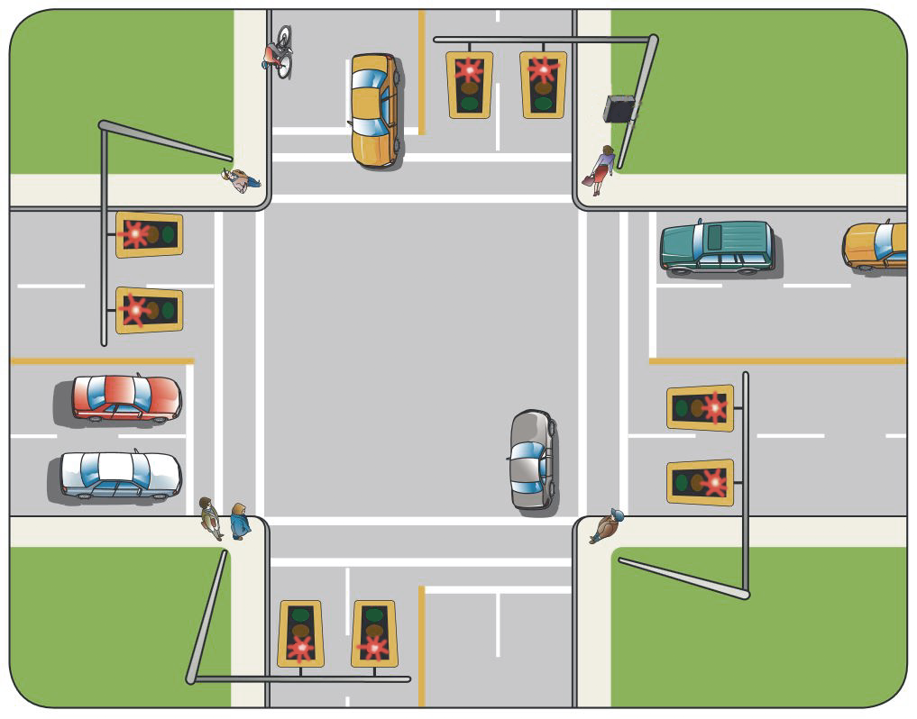

go_ew,left_ew
go_ns,left_ns

